Slide 1
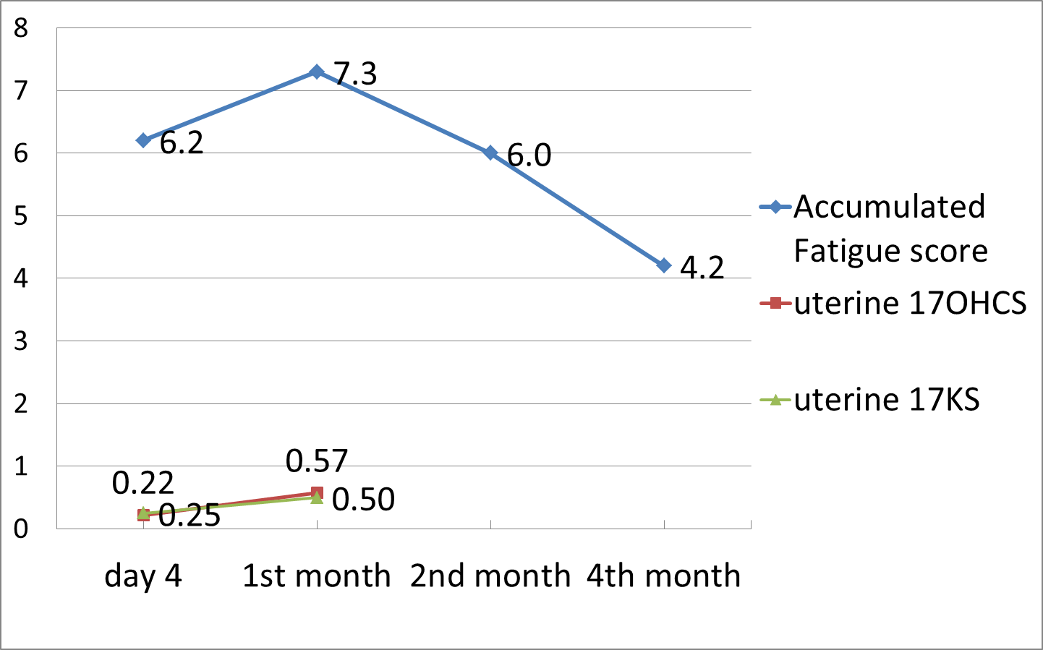
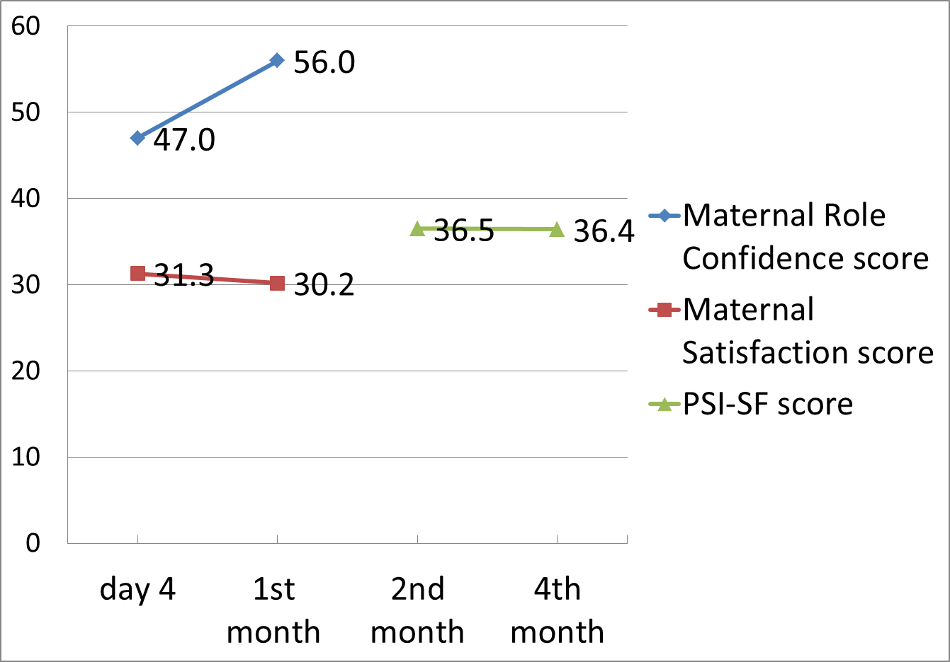
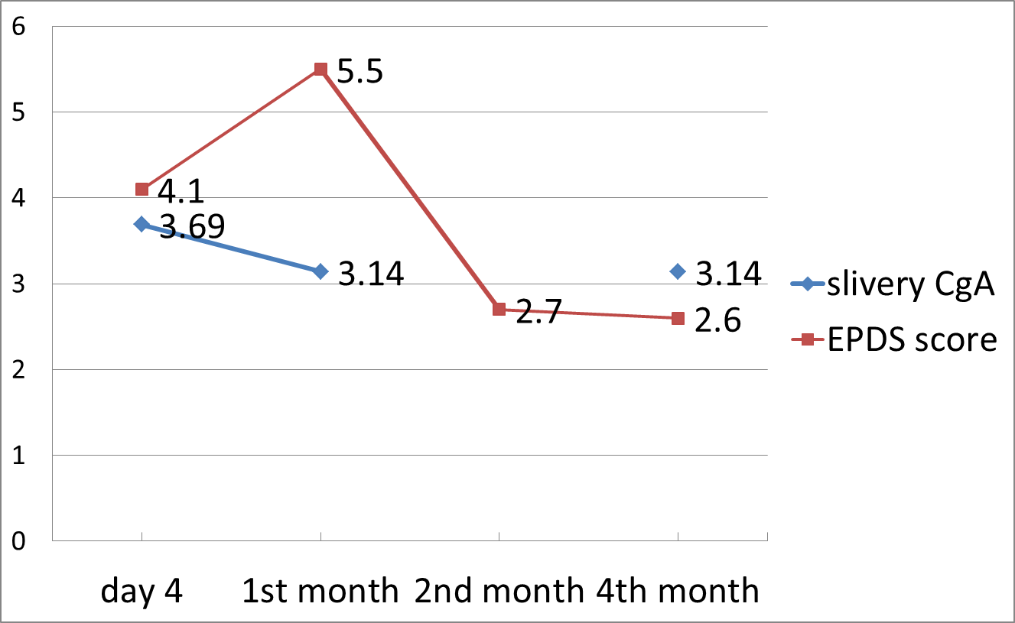

CHANGE IN PHYSICAL AND PSYCHOSOCIAL HEALTH OF JAPANESE FIRST-TIME MOTHERS OVER AGE 35 IN THE 4 MONTHS AFTER CHILDBIRTH
Mori E.，Sakajo A.，Iwata H.，Maehara K.，Ozawa H.，Morita A.，Maekawa T., Tsuchiya M.
Chiba University Graduate School of Nursing, JAPAN
Background and purpose:
Recently, the number of first-time mothers over age 35 has been increasing in Japan. This study aimed to describe the physical and psychosocial health condition of Japanese first-time mothers over age 35 in the 4 months after childbirth.
Methods:
・A longitudinal survey of 21 first-time mothers over age 35 was carried out at day 4, 1 month, 2 months, and 4 months after childbirth.
・Survey items included levels of uterine 17-ketosteroids (17-KS), uterine 17-hydroxycorticosteroids (17-OHCS), and salivary
chromogranin A (CgA) as well as the self-report Accumulated Fatigue Checklist （Ministry of Health, Labour and Welfare，2004 ）,
Edinburgh Postnatal Depression Scale Japanese version (EPDS) （Okano et al，1996）, Maternal Role Confidence Scale and Maternal
Role Satisfaction Scale during the postpartum period （Maehara， 2005 ）, Parenting Stress Index-Short Form (PSI-SF), and background
and daily life activities of the mothers.
・The Chiba University Graduate School of Nursing Institutional Review Board approved the study. All subjects provided informed consent.
Results:
・Table 1 shows demographic obstetric data of the subjects .
・ Accumulated fatigue scores were highest at 1 month and significantly
decreased from the 2nd month through the 4th month.
17-KS and 17-OHCS levels, as indicators of physical stress, increased from
day 4 through 1 month. (Figure 1.)
・EPDS scores for depression were highest at 1 month and significantly
decreased during the 2nd month. Depression scores were correlated with
accumulated fatigue scores at day 4 (rs=0.46, p<.05), 1 month (rs=0.74, p<.01),
2 months (rs=0.69, p<.01), and 4 months (rs=0.69, p<.01).
CgA levels, as an indicator of psychological stress, were highest at day 4 and
had slightly decreased at 1 month, and were constant from the 1st month
through the 4th month. (Figure 2.)
・Maternal confidence scores significantly increased from day 4 through 1 month,
but maternal satisfaction scores remained constant.
PSI-SF scores were constant from the 2nd month through the 4th month.
(Figure 3.)
Table 1. Demographics and obstetric data of the subjects
（N=21）
 |  | M+SD, n （%）
Age （years） |  | 37.0±2.5
Occupation | Employed Unemployed | 6（28.6） 15（71.4）
Education | High school college University or higher | 5（23.8） 6（28.6） 10（47.6）
Marital status | Married Single | 21（100.0） 0（0.0）
History of mental disease | Yes No | 2（9.5） 19（90.5）
Treatment history for infertility | Experience Inexperience | 5（23.8） 16（76.2）
Model of delivery | Vaginal delivery （normal） Vacuum extraction Cesarean section | 7（33.3） 8（38.1） 6（28.6）
Problems during pregnancy | Occur Not | 8（38.1） 13（61.9）
Problems during delivery | Occur Not | 6（28.6） 15（71.4）
Newborn problems | Occur Not | 3（14.3） 18（85.7）
Type of feeding | Breastfeeding Mixed Bottle | 2（9.5） 19（90.5） 0（0.0）
Times of feeding per day | ＜10 ≧10 | 9（42.9） 12（57.1）
Support person | Husband/mother/ mother-in-law Nobody | 14（66.7） 7（33.3）
**
Mean (N=21)
(mg/dl)
(mg/dl)
Figure 1. Change in physical health condition of mothers
(Accumulated fatigue score: 0～39）
** p< 0.05
**
Mean (N=21)
**
Mean (N=21)
(pmol/mg protein)
Figure 3. Change in social health condition of mothers
Figure 2. Change in psychological health condition of mothers
(Maternal Role Confidence score: 20～80, Maternal Role Satisfaction score: 9～36, PSI-SF score: 19～95)
(EPDS score: 0～30)
** p< 0.01
** p< 0.01
Conclusion: Levels of fatigue and depression in first-time mothers over age 35 reach a peak at 1 month after childbirth.
Nursing support programs that promote physical and psychosocial health following childbirth should be further developed.
This study was supported by a Funding Program for the Next Generation World-Leading Researchers（No. LS022）, from the Cabinet Office and the Japan Society for the Promotion of Science , Japan.
Correspondence: Emi Mori, RN, RM, PhD
Professor of Department of Parent and Child Nursing, Graduate School of Nursing, Chiba University
1-8-1 Inohana, Chuo-ku, Chiba city, 280-8672, Japan Email: mori@faculty.chiba-u.jp

